Slide 1

Soldering station
Quinten Mathijs
7/06/2023

Slide 2

Introduction
The concept
The importance
The guidance

Slide 3
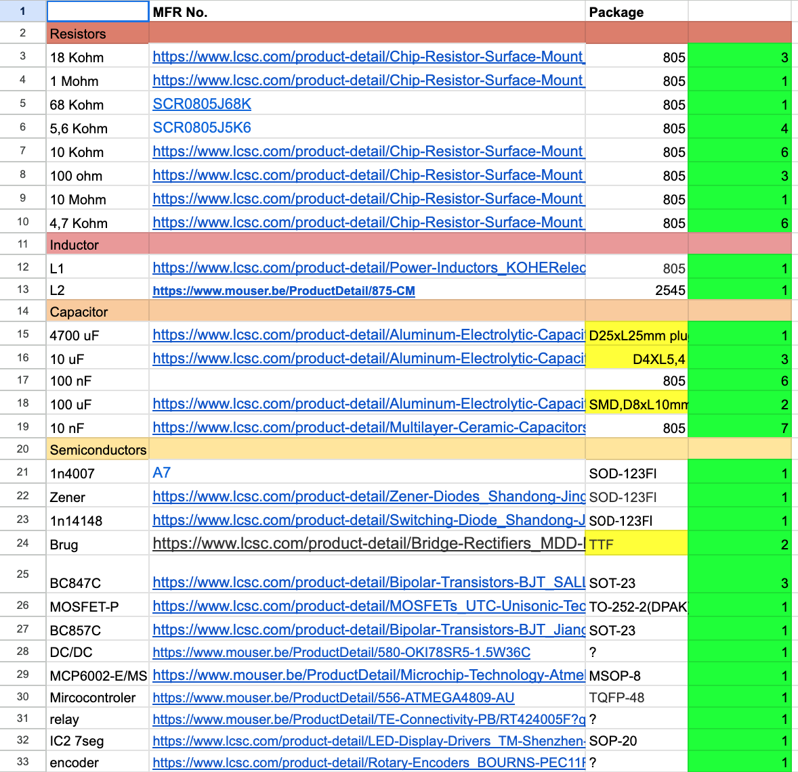

Component sourcing
Use of Eleketor
Group buy
Remaining components → Gotron

Slide 4
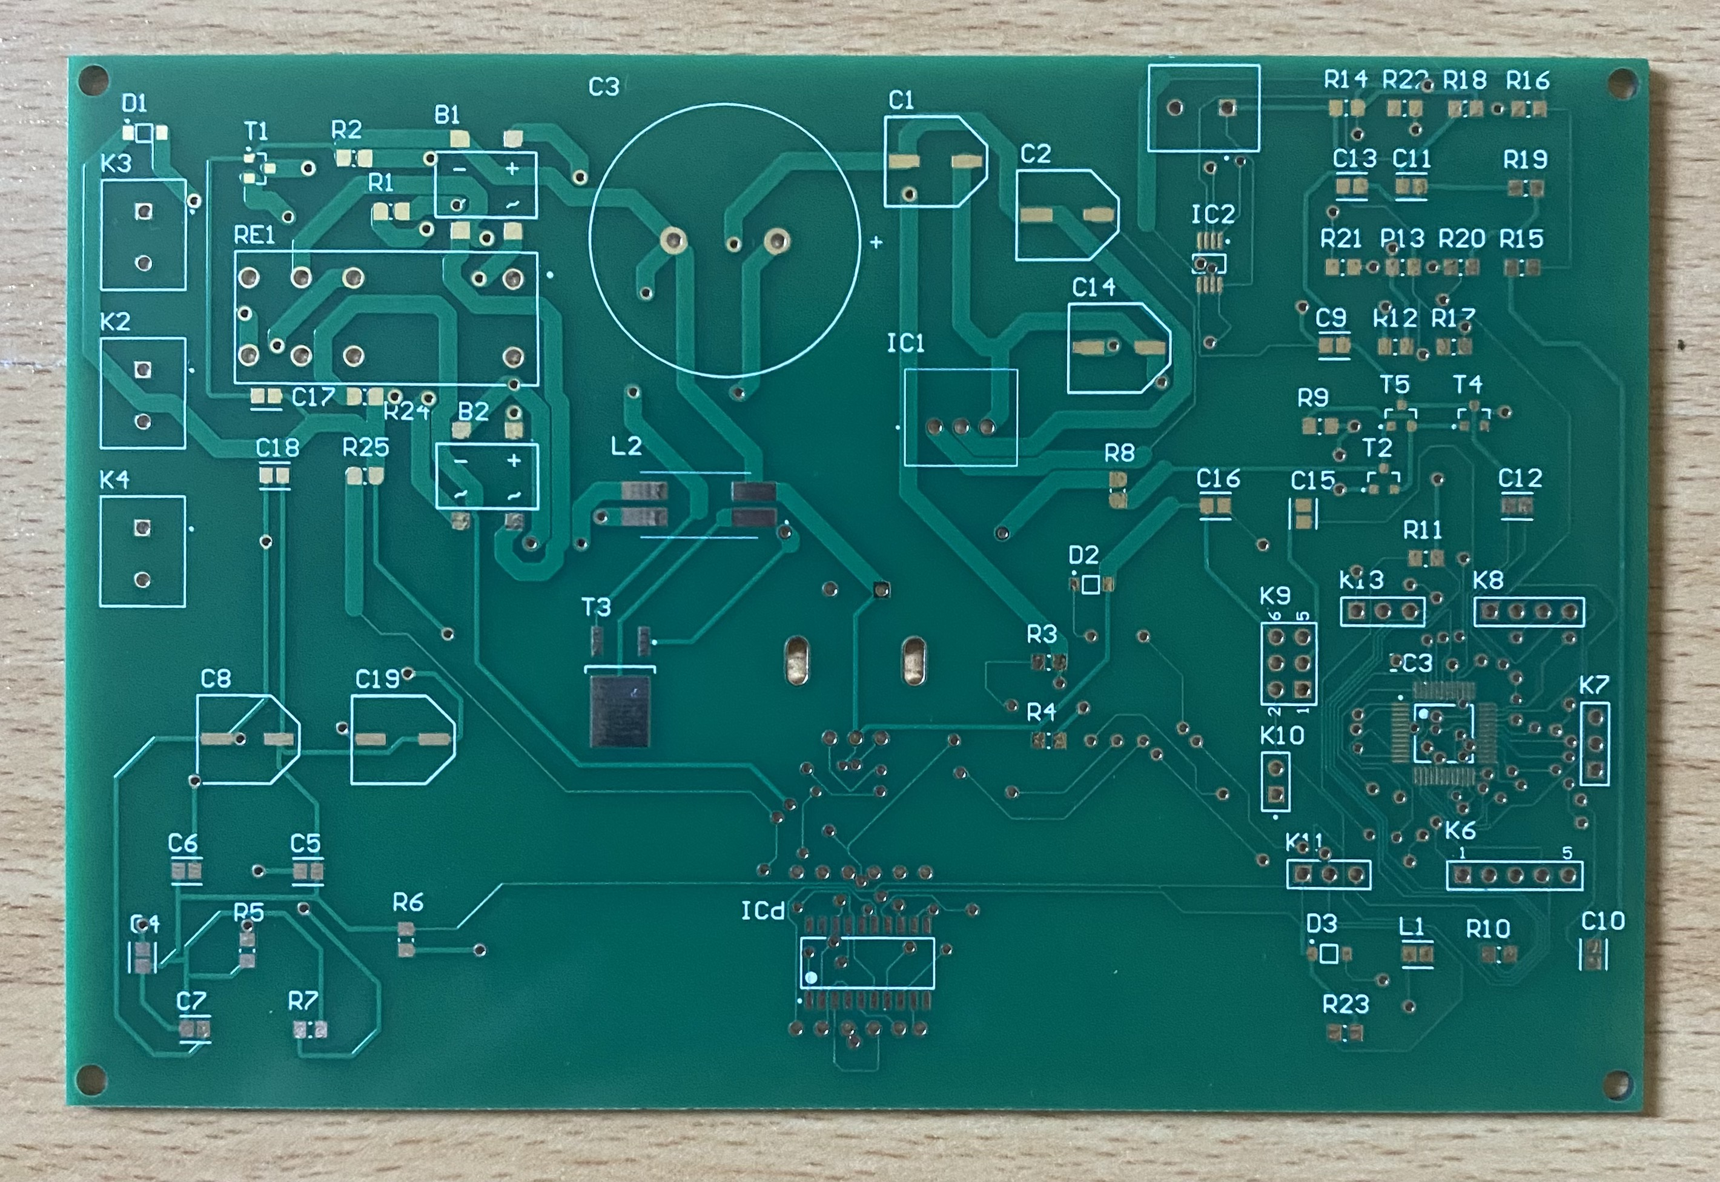
Materials and methods
Starting point → Elektor
The design proces
Schematic modifications
Custom PCB design
Footprints
JLC PCB

Slide 5
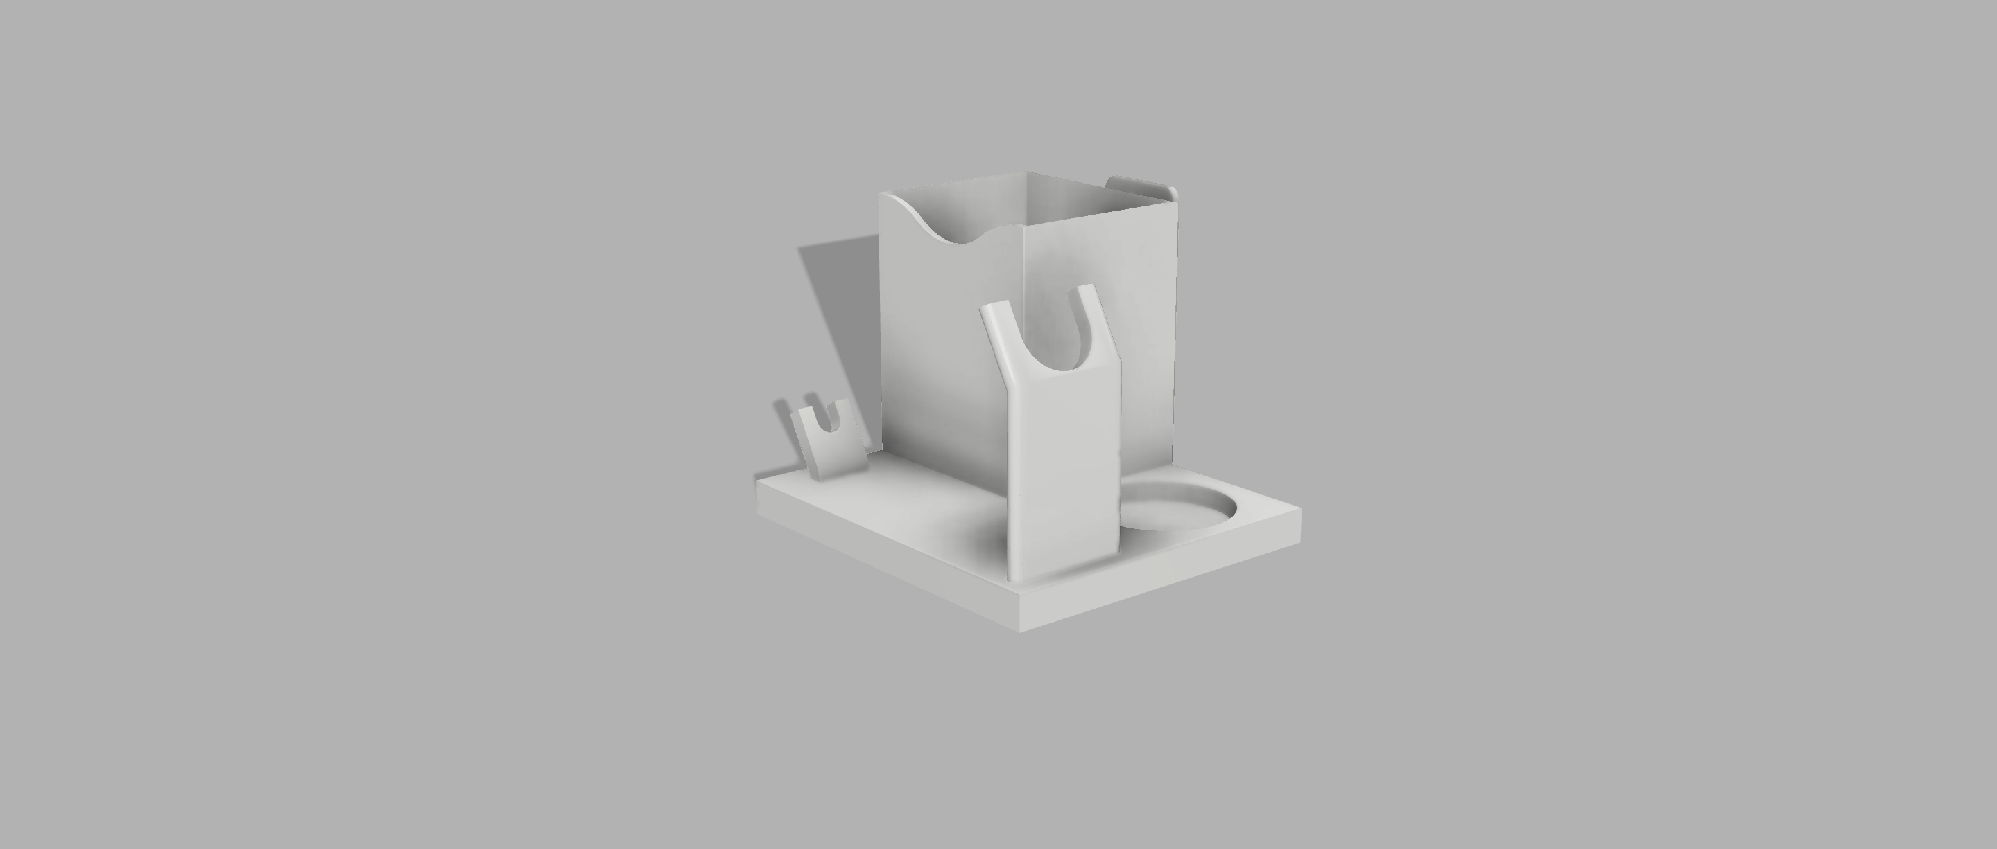

Case design
Fusion 360
The considerations
Dimensions
Necessary openings

Slide 6
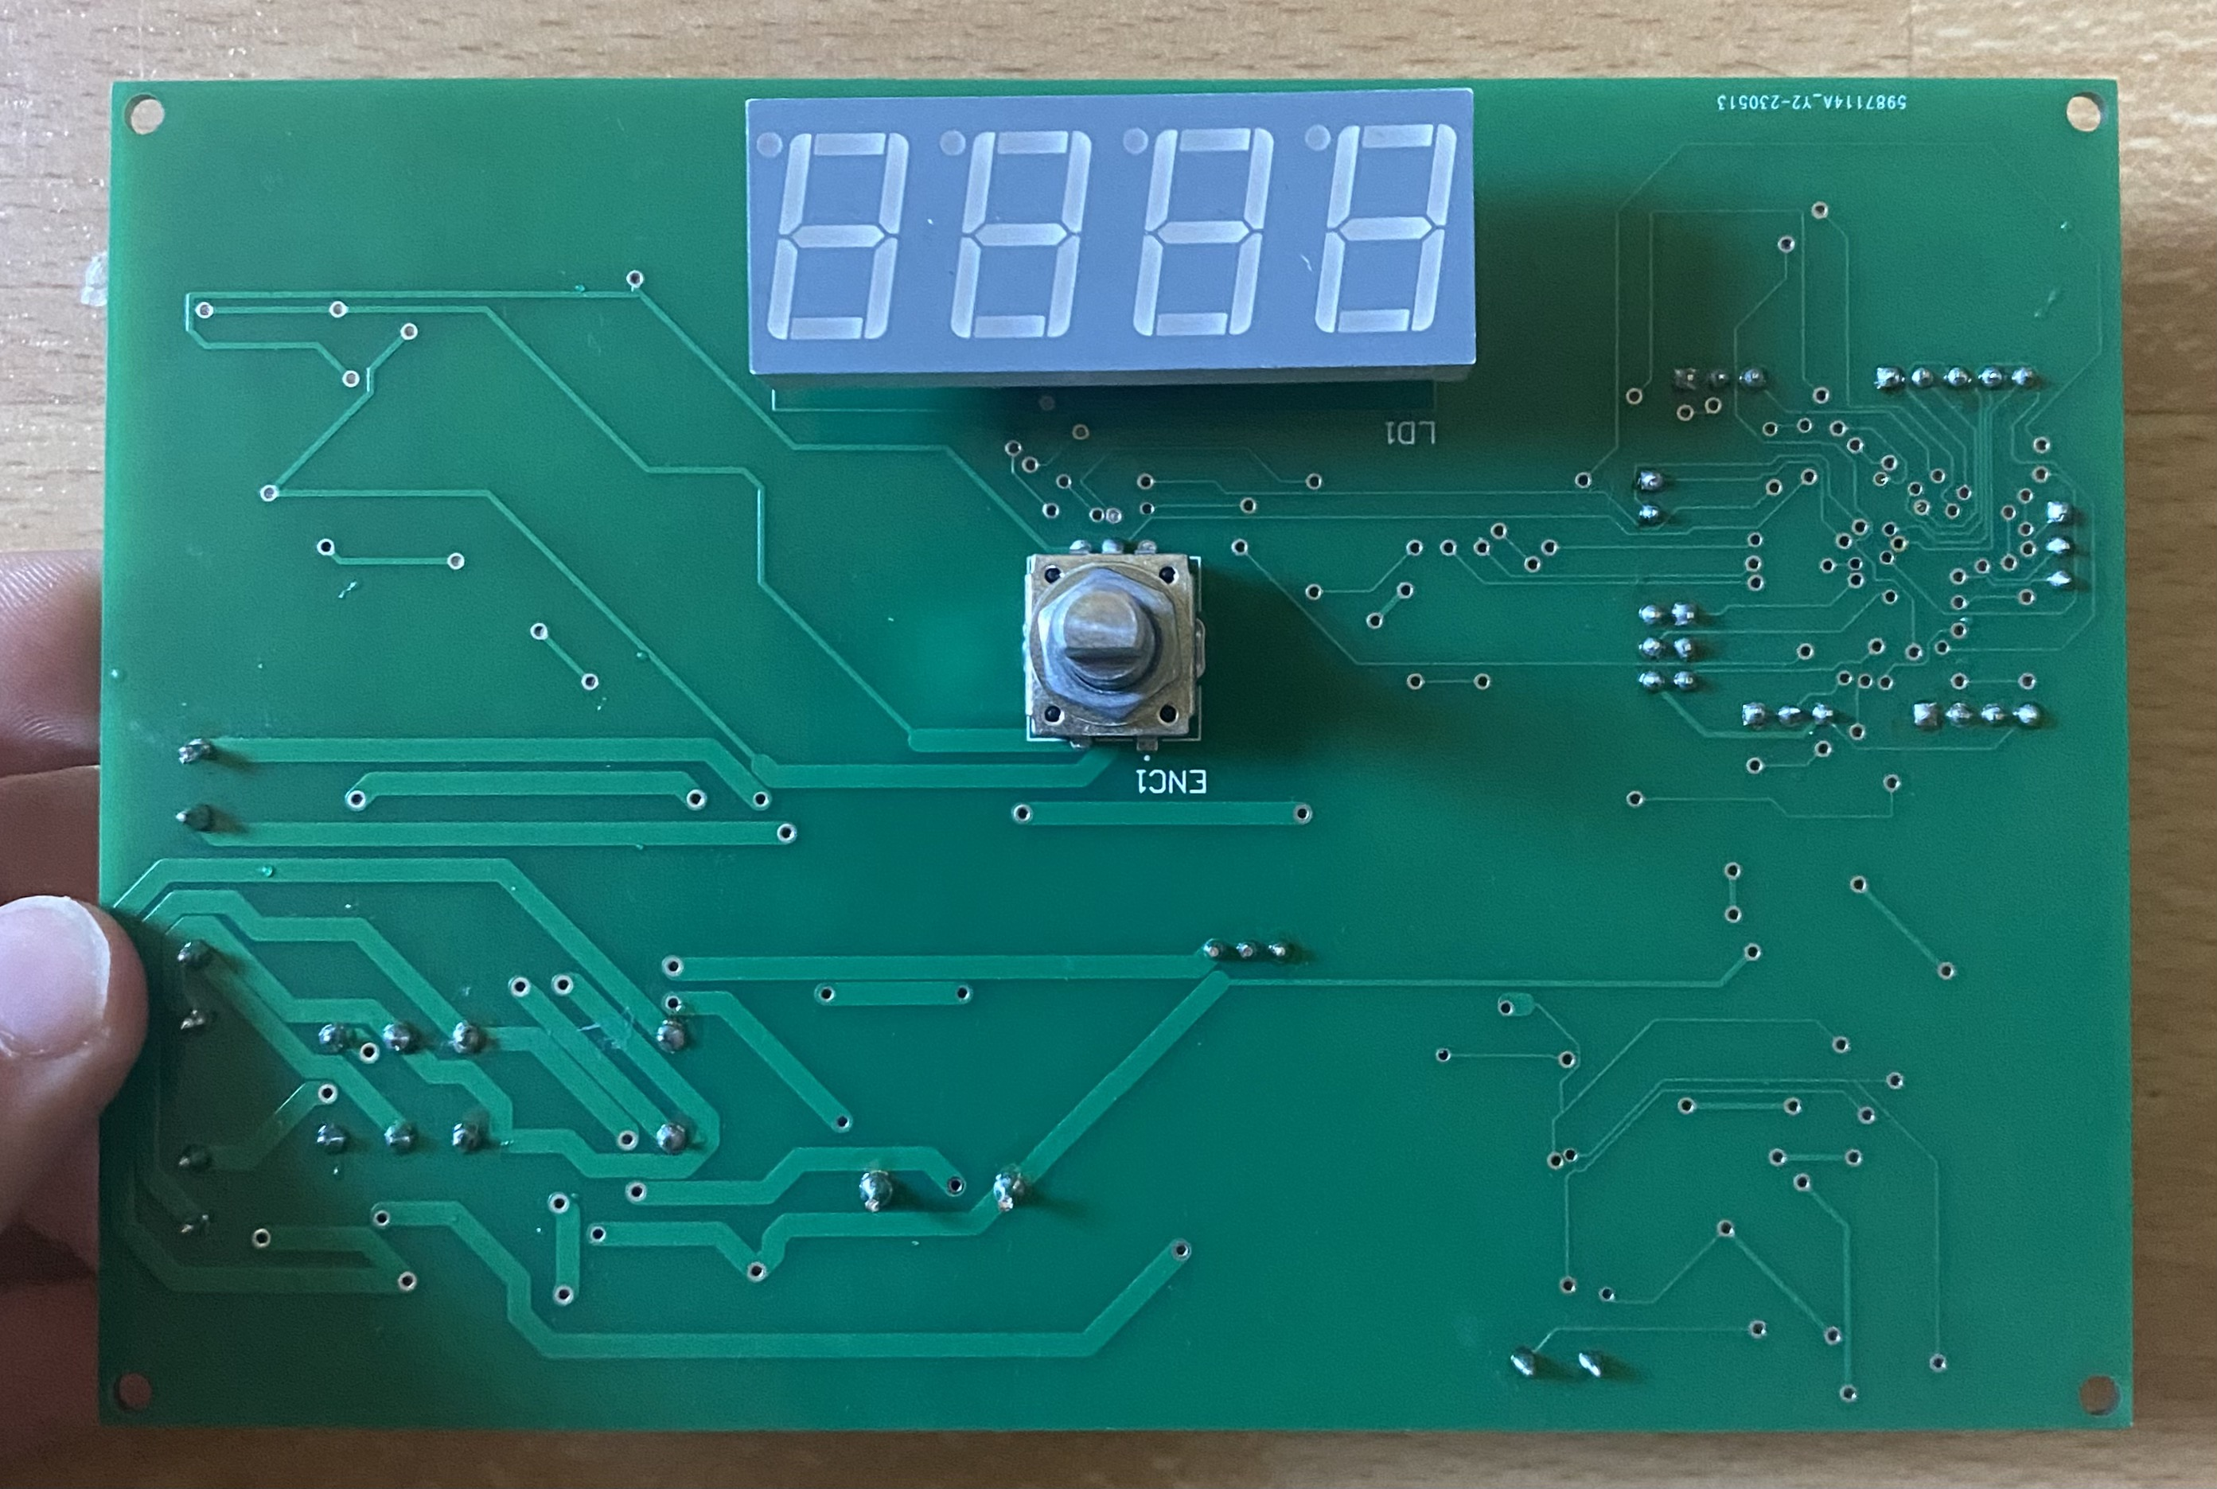
Functionality and features
Temperature control
Display panel
Importance of schematics

Slide 7
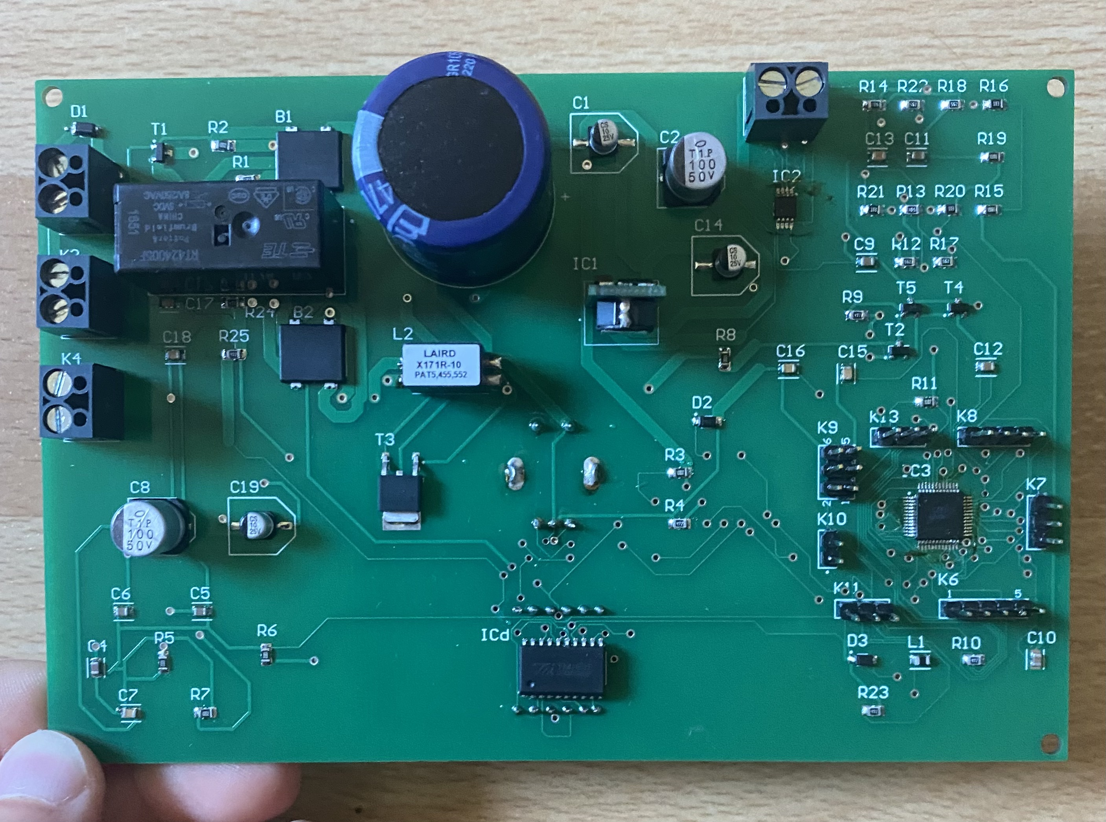
PCB design and issue
Electrical schematics → PCB layout
MOSFET problem
Excessive heat
Process of rectifying
→ reconnecting MOSFET correctly

Slide 8
Testing
Different test conducted
Visual inspection
Voltage measurements
Functional test

Slide 9
Results and discussion
→ functionality !
MOSFET issue
Fusion 360
Reflection + learned lessons

Slide 10
Conclusion
Growth in PCB design

Slide 11
Q&A

